Slide 1
RB Tree Deletion

Slide 2
Node Deletion
in
Binary Search Tree

Slide 3
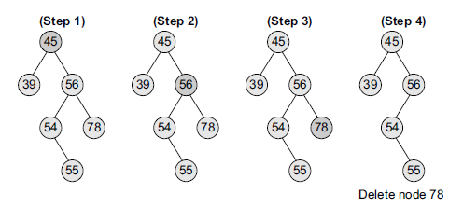
Deletion from Binary Search Tree
Case 1: Deleting a Node that has No Children
If we have to delete node 78,
we can simply remove this node without any issue.
This is the simplest case of deletion

Slide 4
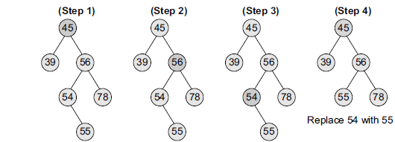
Case 2: Deleting a Node with One Child
the node’s child is set as the child of the node’s parent.
In other words, replace the node with its child.
Deletion of node 54
if the node is the left child of its parent, the node’s child becomes the left child of the node’s parent.
if the node is the right child of its parent, the node’s child becomes the right child of the node’s parent.

Slide 5
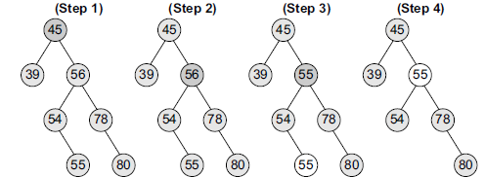
Case 3: Deleting a Node with Two Children
Replace the node’s value with its
in-order predecessor (largest value in the left sub-tree) or
in-order successor (smallest value in the right sub-tree).
deletion of node with value 56.
Using in-order predecessor in the above case.

Slide 6
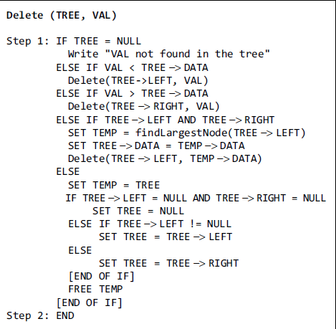
Algorithm for Deletion

Slide 7
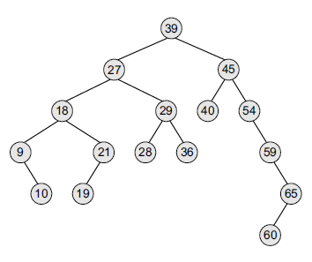
Example- BST Deletion

Slide 8
Step 1 - Perform BST deletion
Step 2
Case 1-If node to be deleted is RED => just delete it [Terminal]
Case 2-If node to be deleted is BLACK but has RED child
=> Replace node with child and color it with BLACK
Or if the Node to be deleted is BLACK & has RED parent => swap the color of Parent & Sibling (terminal)
RB Tree Deletion
Case 3(1) If root node is DB, => remove DB [Terminal]
Case 3(2) – If DB sibling is RED (also has BLACK parent)
➔ swap colors of PARENT and its SIBLING
➔ rotate PARENT in DB direction
➔ reapply cases
Case 3(3) - If DB’s sibling is BLACK and both of its children are BLACK
➔Remove DB (node)
= => Add extra black to its parent
=====> if parent is RED, then make it BLACK
======> if parent is BLACK, then make it double BLACK
➔ Make sibling RED
➔ If stillDB exists, apply other cases.
Case 3(4) – DB’s sibling is BLACK, check sibling child's who is far from DB is BLACK but near child to DB is RED
Swap color of DB’s sibling & siblings child who is near to DB
Rotate sibling in opposite direction to DB
Apply case 6
Case 3(5) – DB’s sibling is BLACK and far child is RED [Terminal]
Swap color of PARENT & SIBLING
Rotate PARENT in DB’s direction
Remove DB
Change color of RED child(far) to BLACK
[if node to be deleted is black , it will be replaced by Double Black DB]

Slide 9
RB tree Deletion
Construct a tree as follows
49, 28, 58, 14, 30, 52, 67, 63, 75, 79
Perform the following deletion
52, 28, 79, 75, 49, 30, 14

Slide 10
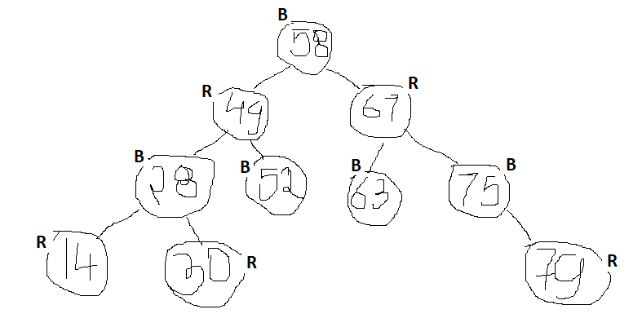
RB tree Deletion
Construct a tree as follows
49, 28, 58, 14, 30, 52, 67, 63, 75, 79
Perform the following deletion
52, 28, 79, 75, 49, 30, 14

Slide 11
Perform the following deletion
52, 28, 79, 75, 49, 30, 14

Slide 12
Step 1 - Perform BST deletion
Step 2
Case 1-If node to be deleted is RED => just delete it [Terminal]
Case 2-If node to be deleted is BLACK but has RED child
=> Replace node with child and color it with BLACK
Or if the Node to be deleted is BLACK & has RED parent => swap the color of Parent & Sibling (terminal)
Case 3(1) If root node is DB, => remove DB [Terminal]
Case 3(2) – If DB sibling is RED (also has BLACK parent)
➔ swap colors of PARENT and its SIBLING
➔ rotate PARENT in DB direction
➔ reapply cases
Case 3(3) - If DB’s sibling is BLACK and both of its children are BLACK
➔Remove DB
= => Add extra black to its parent
=====> if parent is RED, then make it BLACK
======> if parent is BLACK, then make it double BLACK
➔ Make sibling RED
➔ If stillDB exists, apply other cases.
Case 3(4) – DB’s sibling is BLACK, check sibling child's who is far from DB is BLACK
but near child to DB is RED
Swap color of DB’s sibling & siblings child who is near to DB
Rotate sibling in opposite direction to DB
Apply case 3(5)
Case 3(5) – DB’s sibling is BLACK and far child is RED [Terminal]
Swap color of PARENT & SIBLING
Rotate PARENT in DB’s direction
Remove DB
Change color of RED child(far) to BLACK
RB Tree Deletion
52, 28, 79, 75, 49, 30, 14

Slide 13
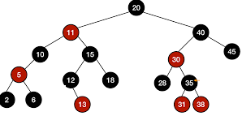
Delete 30, 45, 10, 12, 35

Slide 14
Step 1 - Perform BST deletion
Step 2
Case 1-If node to be deleted is RED => just delete it [Terminal]
Case 2-If node to be deleted is BLACK but has RED child
=> Replace node with child and color it with BLACK
Or if the Node to be deleted is BLACK & has RED parent => swap the color of Parent & Sibling (terminal)
Case 3(1) If root node is DB, => remove DB [Terminal]
Case 3(2) – If DB sibling is RED (also has BLACK parent)
➔ swap colors of PARENT and its SIBLING
➔ rotate PARENT in DB direction
➔ reapply cases
Case 3(3) - If DB’s sibling is BLACK and both of its children are BLACK
➔Remove DB
= => Add extra black to its parent
=====> if parent is RED, then make it BLACK
======> if parent is BLACK, then make it double BLACK
➔ Make sibling RED
➔ If stillDB exists, apply other cases.
Case 3(4) – DB’s sibling is BLACK, check sibling child's who is far from DB is BLACK
but near child to DB is RED
Swap color of DB’s sibling & siblings child who is near to DB
Rotate sibling in opposite direction to DB
Apply case 3(5)
Case 3(5) – DB’s sibling is BLACK and far child is RED [Terminal]
Swap color of PARENT & SIBLING
Rotate PARENT in DB’s direction
Remove DB
Change color of RED child(far) to BLACK
RB Tree Deletion
Delete 30, 45, 10, 12, 35

Slide 15
RB Tree Deletion
Delete 30, 45, 10, 12, 35
Step 1 - Perform BST deletion
Step 2
Case 1-If node to be deleted is RED => just delete it [Terminal]
Case 2-If node to be deleted is BLACK but has RED child
=> Replace node with child and color it with BLACK
Or if the Node to be deleted is BLACK & has RED parent => swap the color of Parent & Sibling (terminal)
Case 3(1) If root node is DB, => remove DB [Terminal]
Case 3(2) – If DB sibling is RED (also has BLACK parent)
➔ swap colors of PARENT and its SIBLING
➔ rotate PARENT in DB direction
➔ reapply cases
Case 3(3) - If DB’s sibling is BLACK and both of its children are BLACK
➔Remove DB
= => Add extra black to its parent
=====> if parent is RED, then make it BLACK
======> if parent is BLACK, then make it double BLACK
➔ Make sibling RED
➔ If stillDB exists, apply other cases.
Case 3(4) – DB’s sibling is BLACK, check sibling child's who is far from DB is BLACK but near child to DB is RED
Swap color of DB’s sibling & siblings child who is near to DB
Rotate sibling in opposite direction to DB
Apply case 6
Case 3(5) – DB’s sibling is BLACK and far child is RED [Terminal]
Swap color of PARENT & SIBLING
Rotate PARENT in DB’s direction
Remove DB
Change color of RED child(far) to BLACK
[if node to be deleted is black , it will be replaced by Double Black DB]

Slide 16
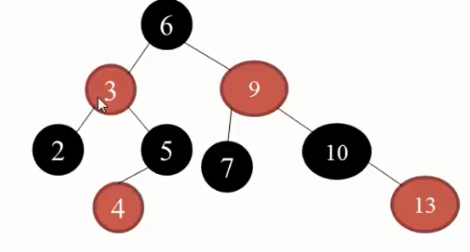
Delete 9, 3, 4, 10, 13, 2

Slide 17
Step 1 - Perform BST deletion
Step 2
Case 1-If node to be deleted is RED => just delete it [Terminal]
Case 2-If node to be deleted is BLACK but has RED child
=> Replace node with child and color it with BLACK
Or if the Node to be deleted is BLACK & has RED parent => swap the color of Parent & Sibling (terminal)
Case 3(1) If root node is DB, => remove DB [Terminal]
Case 3(2) – If DB sibling is RED (also has BLACK parent)
➔ swap colors of PARENT and its SIBLING
➔ rotate PARENT in DB direction
➔ reapply cases
Case 3(3) - If DB’s sibling is BLACK and both of its children are BLACK
➔Remove DB
= => Add extra black to its parent
=====> if parent is RED, then make it BLACK
======> if parent is BLACK, then make it double BLACK
➔ Make sibling RED
➔ If stillDB exists, apply other cases.
Case 3(4) – DB’s sibling is BLACK, check sibling child's who is far from DB is BLACK
but near child to DB is RED
Swap color of DB’s sibling & siblings child who is near to DB
Rotate sibling in opposite direction to DB
Apply case 3(5)
Case 3(5) – DB’s sibling is BLACK and far child is RED [Terminal]
Swap color of PARENT & SIBLING
Rotate PARENT in DB’s direction
Remove DB
Change color of RED child(far) to BLACK
RB Tree Deletion
Delete 9, 3, 4, 10, 13, 2

Slide 18
Delete 9, 3, 4, 10, 13, 2
RB Tree Deletion
Step 1 - Perform BST deletion
Step 2
Case 1-If node to be deleted is RED => just delete it [Terminal]
Case 2-If node to be deleted is BLACK but has RED child
=> Replace node with child and color it with BLACK
Or if the Node to be deleted is BLACK & has RED parent => swap the color of Parent & Sibling (terminal)
Case 3(1) If root node is DB, => remove DB [Terminal]
Case 3(2) – If DB sibling is RED (also has BLACK parent)
➔ swap colors of PARENT and its SIBLING
➔ rotate PARENT in DB direction
➔ reapply cases
Case 3(3) - If DB’s sibling is BLACK and both of its children are BLACK
➔Remove DB
= => Add extra black to its parent
=====> if parent is RED, then make it BLACK
======> if parent is BLACK, then make it double BLACK
➔ Make sibling RED
➔ If stillDB exists, apply other cases.
Case 3(4) – DB’s sibling is BLACK, check sibling child's who is far from DB is BLACK but near child to DB is RED
Swap color of DB’s sibling & siblings child who is near to DB
Rotate sibling in opposite direction to DB
Apply case 6
Case 3(5) – DB’s sibling is BLACK and far child is RED [Terminal]
Swap color of PARENT & SIBLING
Rotate PARENT in DB’s direction
Remove DB
Change color of RED child(far) to BLACK
[if node to be deleted is black , it will be replaced by Double Black DB]

Slide 19
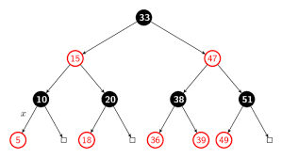

Slide 20
Video Lecture of the topic can be found at
How to Delete Node in Binary Search Tree (BST)
https://www.youtube.com/watch?v=ad1KFYHZyMc
Red Black Tree and Insertion Operation
https://www.youtube.com/watch?v=H0MutN9u-Ik
Understanding RB Tree Deletion cases with an Example
https://youtu.be/1qEjtfR0gIo
RB Tree Deletion Example No.2
https://youtu.be/MjlQo2vRAnI
RB Tree Deletion Example No.3
https://youtu.be/vVRo_WagRLQ

